Slide 1
PROJECT OF:
Data Structure And Algorithm
On:
QUIZERIA
PRESENTED BY:
-RENSA NEUPANE(028)
-BHAWANA ADHIKARI(009)

Slide 2
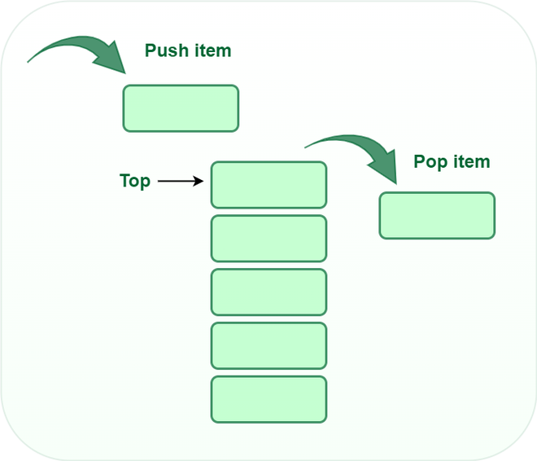
DATA STRUCTURES USED:
STACK:
Stack is a non primitive linear data structures.The last added element will be the first to be removed from the stack. That’s why stack is also called Last in first out(LIFO).

Slide 3
Stack operations:
1.PUSH:
Adds an item in the stack.If the stack is full then,it is said to be a overflow conditions.
2.POP:
Removes an item from the stack.The items are popped in the reversed order in which they are pushed.If the stack is empty then it is said to be an underflow conditions.
3.PEEK:
Return top element of stack.

Slide 4
About the project:
The program which we have implemented is a quiz which uses stacks as its underlying data structures.
The quiz includes 10 questions which are pushed into the stack with the decreasing order of their difficulty.
You will be given a four options.
If you give a right answers you score(10-i)*10 points,i stands for a position where the question is present in the stack. i.e points will increase linearly with 10,20,..upto 100.

Slide 5
About the project:
According to the above formula the maximum points that can be obtained is 550.
If you answer all the questions correctly then you will win the quiz.
If you wish to quit the quiz midway you can select the options ‘0’,by doing this you will be removed from the quiz and will get points for the correct answers.

Slide 6
ALGORITHM:
Step 1: INITIALIZATION points=0
top=-1
max=10
i=9
Step 2: STORING QUESTION AND ANSWER
Construct 2D array name stackQ of size 10*256
Initialize the stack with the questions of decreasing difficulty such that easiest questions is pushed last to pop first.Push answer into the array name stackAns.
Step 3: Print ’welcome’
Scan name
Step 4: print stackQ[i]
Scan ans

Slide 7
if(ans=stackAns[i])
points=points+(10-i)*10
Print “correct”
Else if(ans=0)
print(‘you quit’)
Else
Print “correct ans is %d”,stackAns
points=points-50
Break
Step 5: i--
if(i>=0)
Goto STEP 4
Step 6: print points
Step 7: end

Slide 8
Code:
#include<string.h>
#include<stdlib.h>
#include<stdio.h>
#define max 10
char stackQ[max][256];
int stackAns[max];
int top=-1;
void pushAns(int a)
{
top=top+1;
stackAns[top]=a;
}
int main()
{
printf("A miniproject brought to you by\n Bhawana adhikari and Rensa neupane\n");
printf("A quiz using STACK as the data structure to pop the first and most valued question at last.\n");
int points=0,i,ans;
char name[100];

Slide 9
char stackQ[max][256] = {
"Final Question!!\nWhich of the following is linear data structure?\n1)tree\t2)graph\t3)none\t4)array",
"9th Question!!\nWhich of the following is non-linear data structure?\n1)none\t2)array\t3)list\t4)Stack",
"8th Question!!\nStack is based on which principle?\n1)LIFO\t2)FIFO\t3)PUSH\t4)none",
"7th Question!!\nWe use theta notation for \n1)worst case\t2)Best case\t3)average case\t4)none",
"6th Question!!\nMinimum how many stacks are needed to implement a queue\n1)2\t2)12\t3)0\t4)10",
"5th Question!!\n Queue is based on which principle? \n1)FIFO\t2)LIFO\t3)PULL\t4)none",
"4th Question!!\nFunction is to specify the data type\n1)typedef\t2)arr\t3)none\t4)id",
"3rd Question!!\nA function which calls itself is called \n1)iteration\t2)algorithm\t3)recursion\t4)none",
"2nd Question!!\nrecursion is based on \n1)stack\t2)queue\t3)none\t4)tree",
"1st Question!!\nLinear Search is best for \n1)large arrays\t2)small arrays\t3)none\t4)sorted arrays"};

Slide 10
pushAns(4); //push 10 ans.
pushAns(1);
pushAns(1);
pushAns(3);
pushAns(1);
pushAns(1);
pushAns(1);
pushAns(3);
pushAns(1);
pushAns(1);
printf("\nWelcome to Quiz.\n");
printf("Enter your name. \n");
scanf("%s",name);
printf("Welcome %s\n",name);
for(i=9;i>=0;i--)
{
printf("\n\nThis question is for %d points\n",(10-i)*10);
printf("%s\n",stackQ[i]);
printf("Enter your ans :\n");
scanf("%d",&ans);

Slide 11
if(ans==stackAns[i])
{
points=points+(10-i)*10;
printf("Congrats!!!\t You earn %d points\n",(10-i)*10);
}
else if(ans==0)
{
printf("You chose to quit\n");
break;
}
else
{
printf("Sorry, the correct answer is %d. \n",stackAns[i]);
break;
}
}

Slide 12
if(points==550)
{
printf("You are the winner of the quizeria with %d points!!!\n",points);
}
else {
printf("Sorry, the correct answer is %d. \n",stackAns[i]);
}
printf("You scored %d points!!!\n",points);
}

Slide 13
Output:
A miniproject brought to you by
Bhawana adhikari and Rensa neupane
A quiz using STACK as the data structure to pop the first and most valued question at last.
Welcome to Quiz.
Enter your name.
rensa
Welcome rensa
This question is for 10 points
1st Question!!
Linear Search is best for
1)large arrays 2)small arrays 3)none 4)sorted arrays
Enter your ans :
2
Sorry, the correct answer is 1.
Sorry, the correct answer is 1.
You scored 0 points!!!
.

Slide 14
Output:
A miniproject brought to you by
Bhawana adhikari and Rensa neupane
A quiz using STACK as the data structure to pop the first and most valued question at last.
Welcome to Quiz.
Enter your name.
rensa
Welcome rensa
This question is for 10 points
1st Question!!
Linear Search is best for
1)large arrays 2)small arrays 3)none 4)sorted arrays
Enter your ans :
1
Congrats!!! You earn 10 points

Slide 15
This question is for 20 points
2nd Question!!
recursion is based on
1)stack 2)queue 3)none 4)tree
Enter your ans :
0
You chose to quit
Sorry, the correct answer is 1.
You scored 10 points!!!
...Program finished with exit code 0
Press ENTER to exit console.

Slide 16
Output:
A miniproject brought to you by
Bhawana adhikari and Rensa neupane
A quiz using STACK as the data structure to pop the first and most valued question at last.
Welcome to Quiz.
Enter your name.
rensa
Welcome rensa
This question is for 10 points
1st Question!!
Linear Search is best for
1)large arrays 2)small arrays 3)none 4)sorted arrays
Enter your ans :
1
Congrats!!! You earn 10 points

Slide 17
This question is for 20 points
2nd Question!!
recursion is based on
1)stack 2)queue 3)none 4)tree
Enter your ans :
1
Congrats!!! You earn 20 points
This question is for 30 points
3rd Question!!
A function which calls itself is called
1)iteration 2)algorithm 3)recursion 4)none
Enter your ans :
3
Congrats!!! You earn 30 points

Slide 18
This question is for 40 points
4th Question!!
Function is to specify the data type
1)typedef 2)arr 3)none 4)id
Enter your ans :
1
Congrats!!! You earn 40 points
This question is for 50 points
5th Question!!
Queue is based on which principle?
1)FIFO 2)LIFO 3)PULL 4)none
Enter your ans :
1
Congrats!!! You earn 50 points

Slide 19
This question is for 60 points
6th Question!!
Minimum how many stacks are needed to implement a queue
1)2 2)12 3)0 4)10
Enter your ans :
1
Congrats!!! You earn 60 points
This question is for 70 points
7th Question!!
We use theta notation for
1)worst case 2)Best case 3)average case 4)none
Enter your ans :
3
Congrats!!! You earn 70 points

Slide 20
This question is for 80 points
8th Question!!
Stack is based on which principle?
1)LIFO 2)FIFO 3)PUSH 4)none
Enter your ans :
1
Congrats!!! You earn 80 points
This question is for 90 points
9th Question!!
Which of the following is non-linear data structure?
1)none 2)array 3)list 4)Stack
Enter your ans :
1
Congrats!!! You earn 90 point

Slide 21
This question is for 100 points
Final Question!!
Which of the following is linear data structure?
1)tree 2)graph 3)none 4)array
Enter your ans :
4
Congrats!!! You earn 100 points
You are the winner of the quizeria with 550 points!!!
You scored 550 points!!!
...Program finished with exit code 0
Press ENTER to exit console.

Slide 22
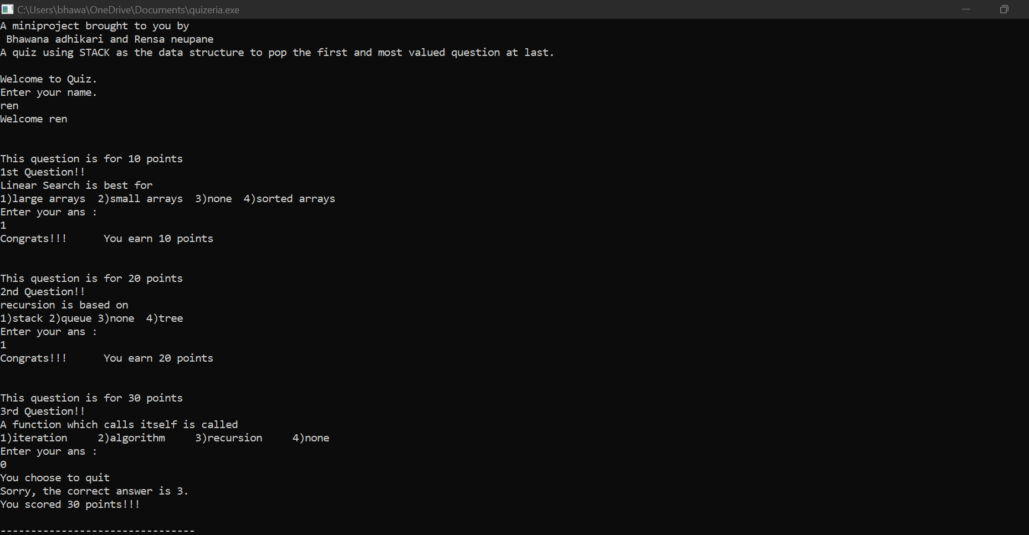

Slide 23
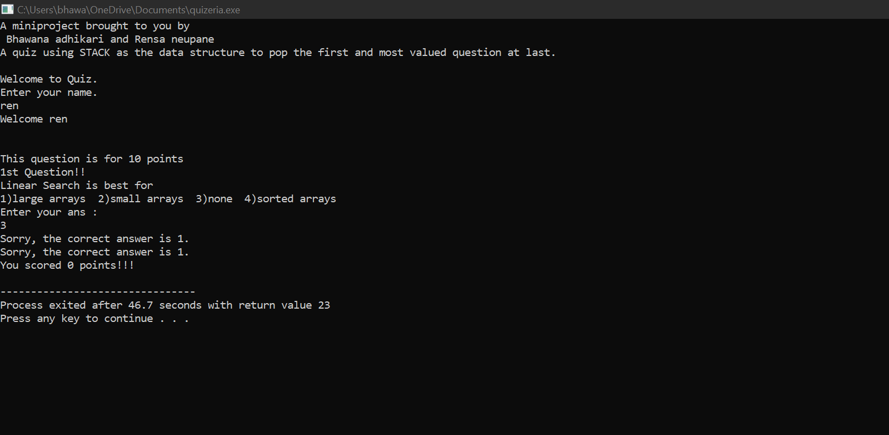

Slide 24
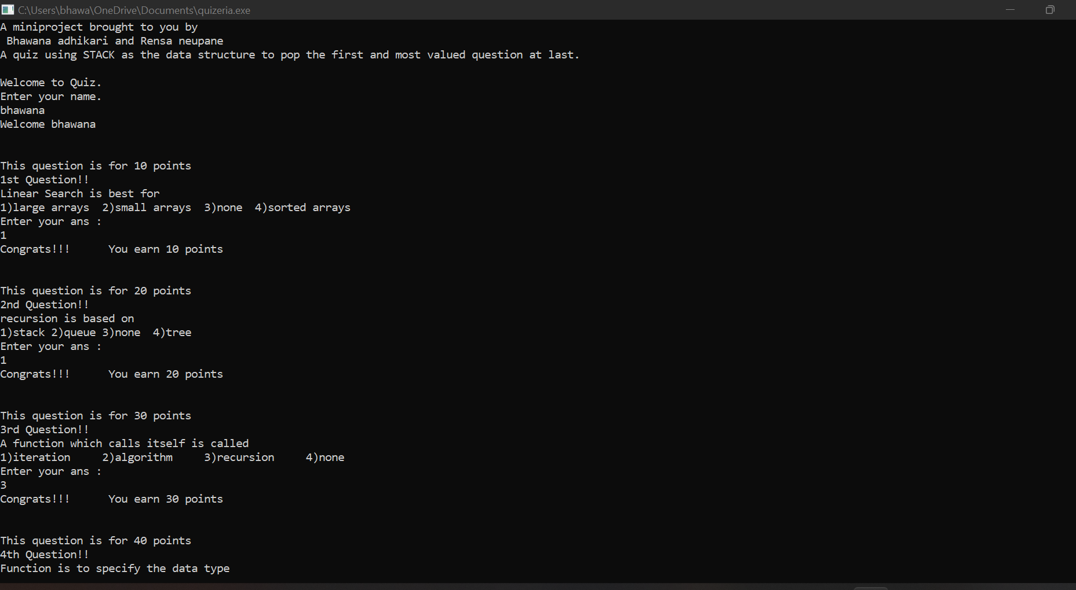

Slide 25
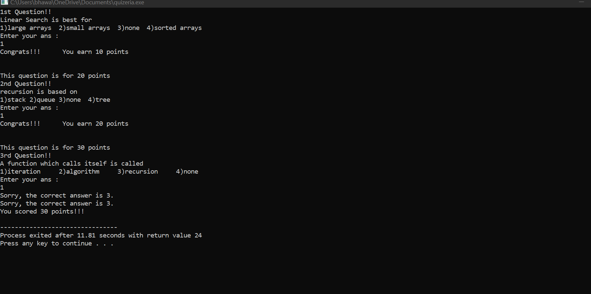

Slide 26
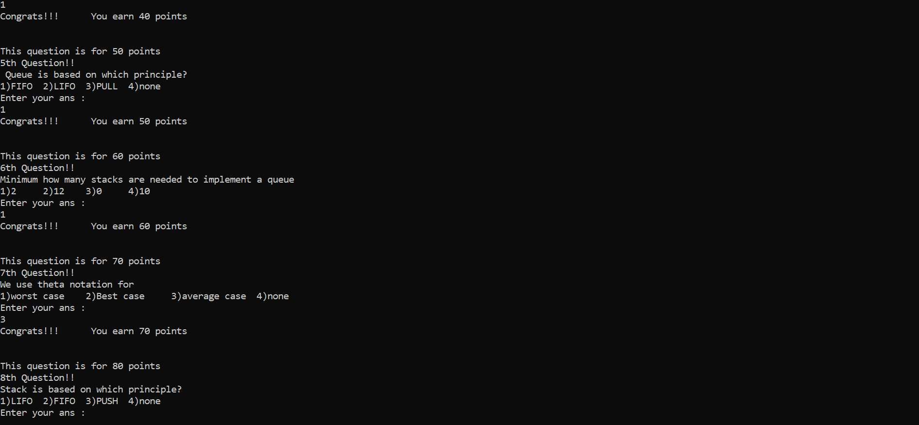

Slide 27
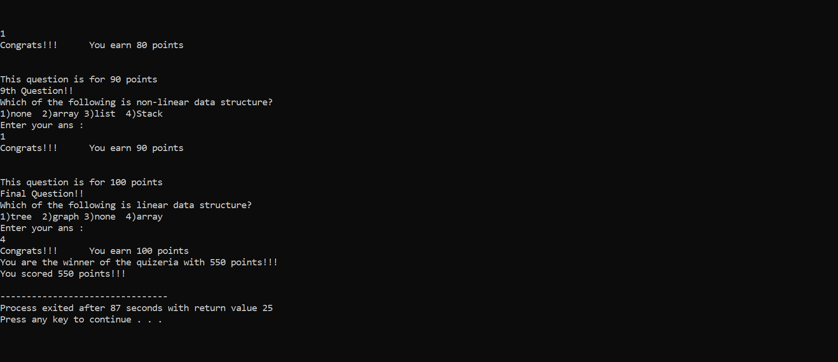

Slide 28


